Slide 1
SIPA Overview
SIPA User Conference
September 23, 2024
Helping Colorado Governments Put More Information and Services Online

Slide 2
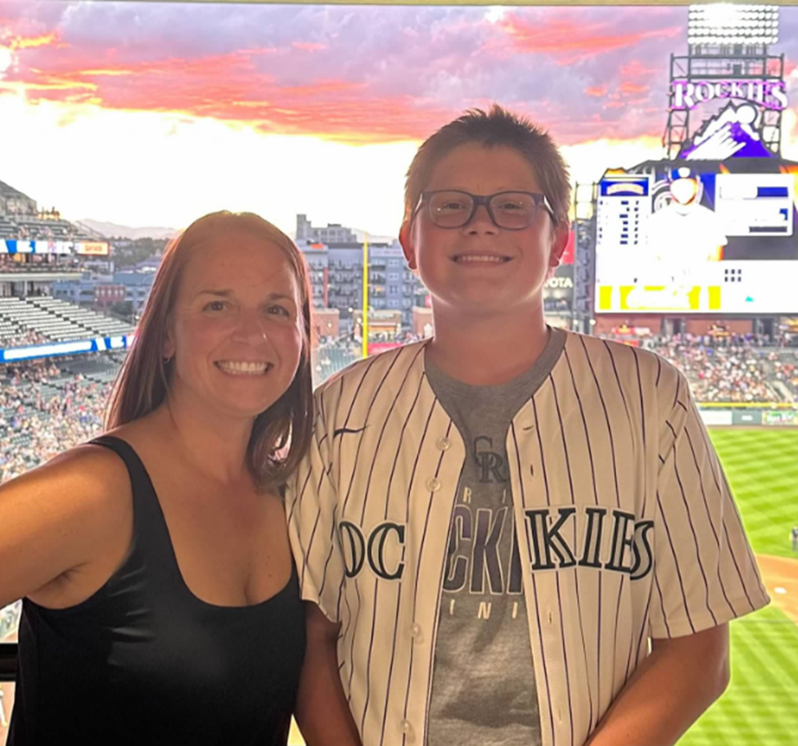
Introductions
Kara Finch joined SIPA in August 2019. As the Contract Manager & Legislative Liaison, she represents SIPA in legislative matters, tracks legislation that impacts the mission of SIPA and the customers SIPA serves, and negotiates and manages software and services contracts. Prior to joining SIPA, Kara worked in higher education procurement at the University of Colorado and the University of Notre Dame.
Duane Tucker joined SIPA in May 2022 serving in a new role as the Customer Success Director. Duane connects customers with SIPA’s portfolio of products and services through the adoption of current and future technology solutions, and focuses on creating a meaningful customer experience. Duane brings many years of experience working in the public sector, most recently as the Director of Strategic Procurement at the University of Colorado.
Notes:
Kara introduce herself. Duane introduce himself.
How many of you currently use SIPA? How many only use the No Cost services? How many use SIPA’s other contracts?
How many of you are in IT?
How many in procurement?
How many play a procurement role even though it is not your job?
Elected officials?

Slide 3
Who is SIPA
We are your government sector partner focused on connecting residents to government through technology by helping to put information and services online - government serving government.
Our
Mission
Our
Vision
Value
Proposition
To provide efficient and effective services for residents through the use of modern business practices and innovative technology solutions.
To transform Colorado government online service delivery through the use of technology.
We leverage technologies to provide resident access to government information, through a simple and cost-effective procurement and contracting process.
Notes:
Kara

Slide 4
Who is SIPA?
C.R.S. § 24-37.7-101 et seq.
The Statewide Internet Portal Authority (SIPA) was created in state statute in 2004 as an independent political subdivision of the state
“The authority shall be a body corporate and a political subdivision of the state and shall not be an agency of the state government and shall not be subject to administrative direction by any department, commission, board, or agency of the state”
SIPA provides electronic information, products, and services to Colorado governments
“Make and execute agreements, contracts, or other instruments necessary or convenient to the exercise of the powers and functions of the authority under this article, including but not limited to contracts with any person, firm, corporation, state agency, local government, or other entity”
Notes:
Kara

Slide 5
Statutory Mission of the Authority
C.R.S. § 24-37.7-105
Develop the officially recognized statewide internet portal that provides one-stop access to electronic information, products, and services in order to give members of the public, state agencies, and local governments an alternative way to transact business with the state
Provide electronic access for members of the public, state agencies, and local governments to electronic information, products, and services through the statewide internet portal
Issue requests for bids or proposals to or contracts with any public or private parties for the design, implementation, operation, and improvement of the distribution of electronic information, products, and services or for services
Explore ways and means of expanding the amount and kind of electronic information, products, and services provided, increasing the utility of the electronic information, products, and services provided and the form in which it is provided
Explore technological means of improving access for members of the public, state agencies, and local governments to electronic information, products, and services, and, where appropriate, implement such technological improvements
Explore options for expanding the statewide internet portal and its services to members of the public, state agencies, and local governments by providing add-on services such as access to other information, products, services, and databases or by providing electronic mail and calendaring to subscribers
Notes:
Kara

Slide 6
Who Can Work with SIPA
All Colorado state agencies and local governments are authorized by statute to contract through SIPA
"Local government" means the government of any county, city and county, home rule or statutory city, town, special district, school district, or other political subdivision of the state
"State agency" means every instrumentality of state government including, but not limited to, the executive department, the legislative department, the judicial department, and all of their respective departments, divisions, commissions, boards, authorities, bureaus, and offices
C.R.S. § 24-37.7-104(q)
All state agencies and local governments are hereby authorized to enter into and do all things necessary to perform any such arrangement or contract with the authority
Notes:
Kara

Slide 7
How to Work with SIPA
SIPA negotiates master contracts with suppliers
Terms and conditions
Pricing
Security standards
Insurance requirements
Execute Eligible Government Entity (EGE) Agreement
Agreement acknowledges that your organization has government status in Colorado.
SIPA’s statute satisfies procurement rules and requirements
No solicitation needed
SIPA works with agency and supplier to create quote or SOW
PO processing and invoicing is between SIPA and EGE
Notes:
Kara

Slide 8
SIPA Supplier Process
Notes:
Kara

Slide 9
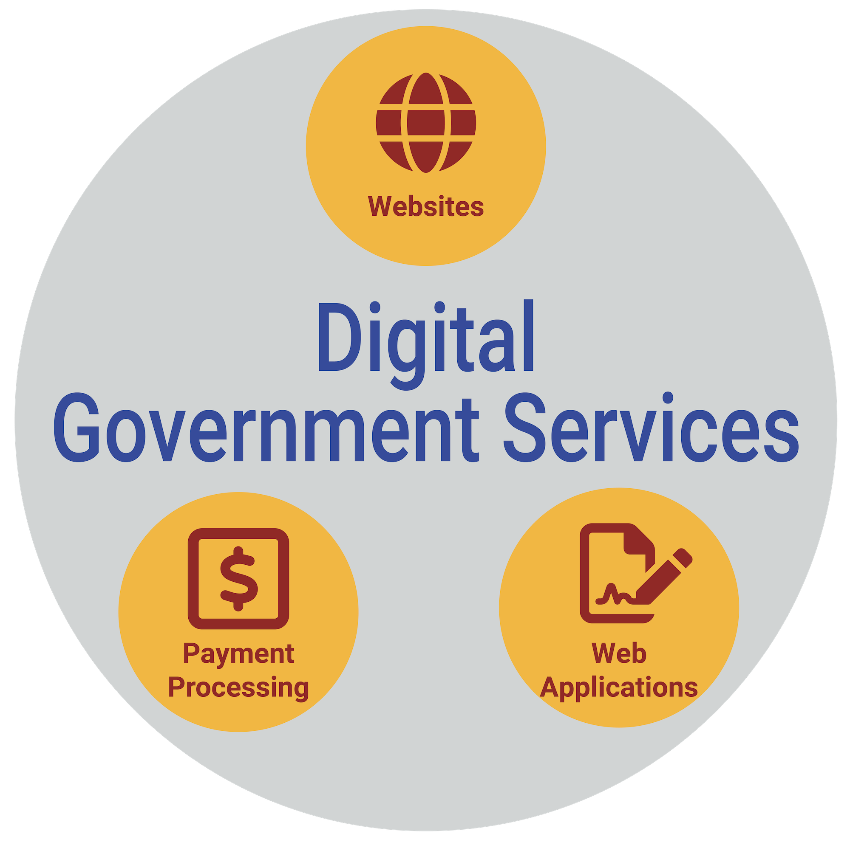
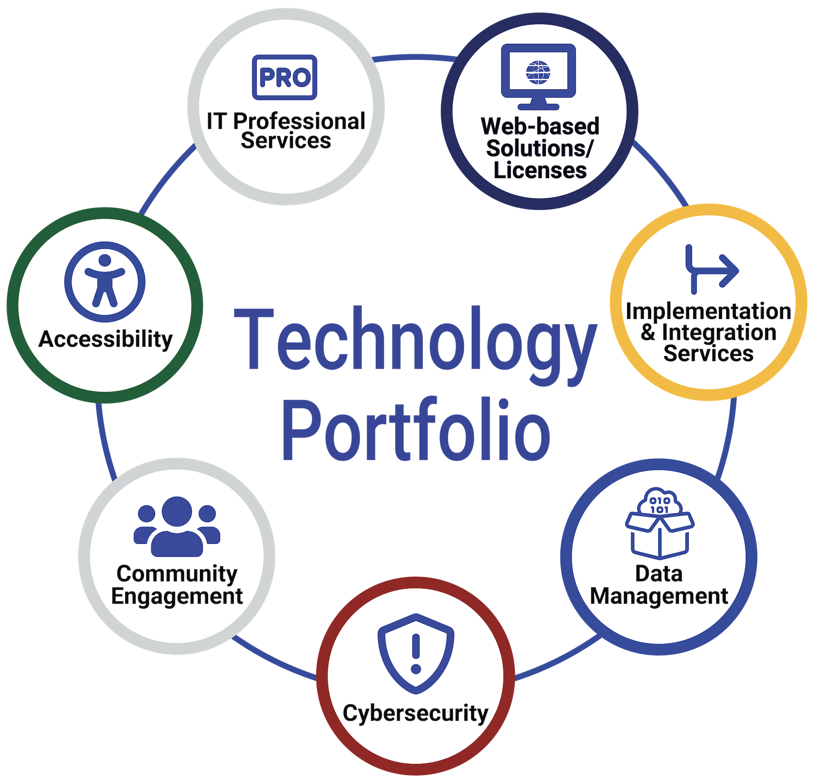
Technology Solutions

Slide 10
Technology Portfolio

Slide 11
How to Work with SIPA Suppliers
1
2
3
4
5
Connect with SIPA
Scoping
Discussion
Supplier
Meetings
SOW Created
PO Issued
‹#›

Slide 12
SIPA Resources
Regional Workshops
Grant Programs
Regional Workshops are collaborative events designed for Colorado governments to help to deliver the best public service for Colorado residents.
SIPA grant programs are designed to connect residents to government through digital government services.
Accessibility | GovGrants | Micro-Grant
sipa.colorado.gov/sipa-grant-programs
Cybersecurity
Accessibility
SIPA partners with suppliers who can assist in strengthening your security, and by sharing valuable webinars, templates, data policy, training plans & more.
sipa.colorado.gov/cybersecurity
Stay current with HB21-1110. We have everything in one place for you to read about the law, compliance grace period, state guidelines, how-to’s, & even a grants
sipa.clorado.gov/i-want-to/learn-more/accessibility
Webinars
Newsletter
Hear from SIPA and its experts on how their solutions can help solves problems with technology issues,, provide ideas for improvement and streamline processes.
Monthly SIPA sends an email with latest government projects implemented, inform you about grant opportunities, webinars, resources and service offerings. Sign up!
sipa.colorado.gov/subscribenewsletter
https://sipa.colorado.gov/i-want-to/sign-up-for/webinarwednesday
‹#›

Slide 13
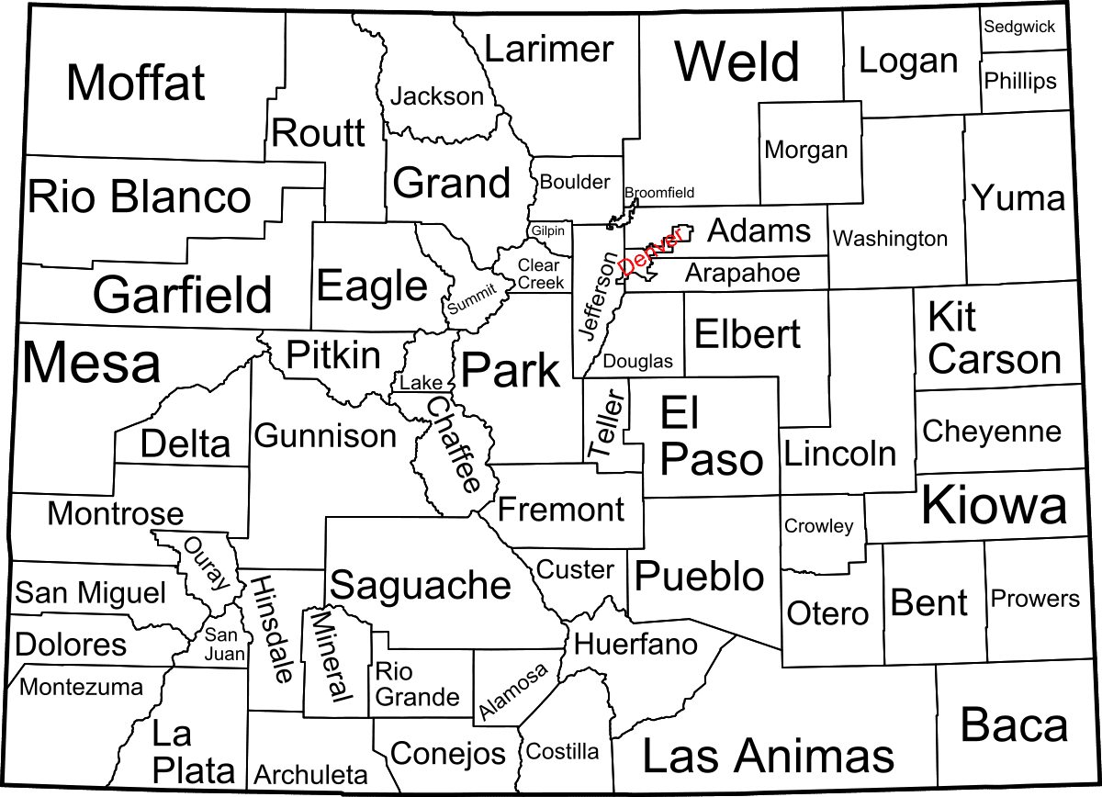
Regional Workshops
Metro Region - October 17 & 18
Englewood
May 2024
Oct. 2024
July 2024
Oct. 2024
Eastern Plains Region - October 29
Akron
Nov. 2024
Southern Region - November 8
Pueblo

Slide 14
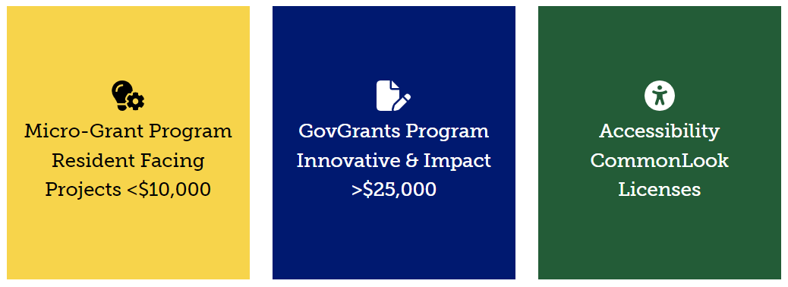
Grants
SIPA grant programs are designed to connect residents to government through digital government services.

Slide 15
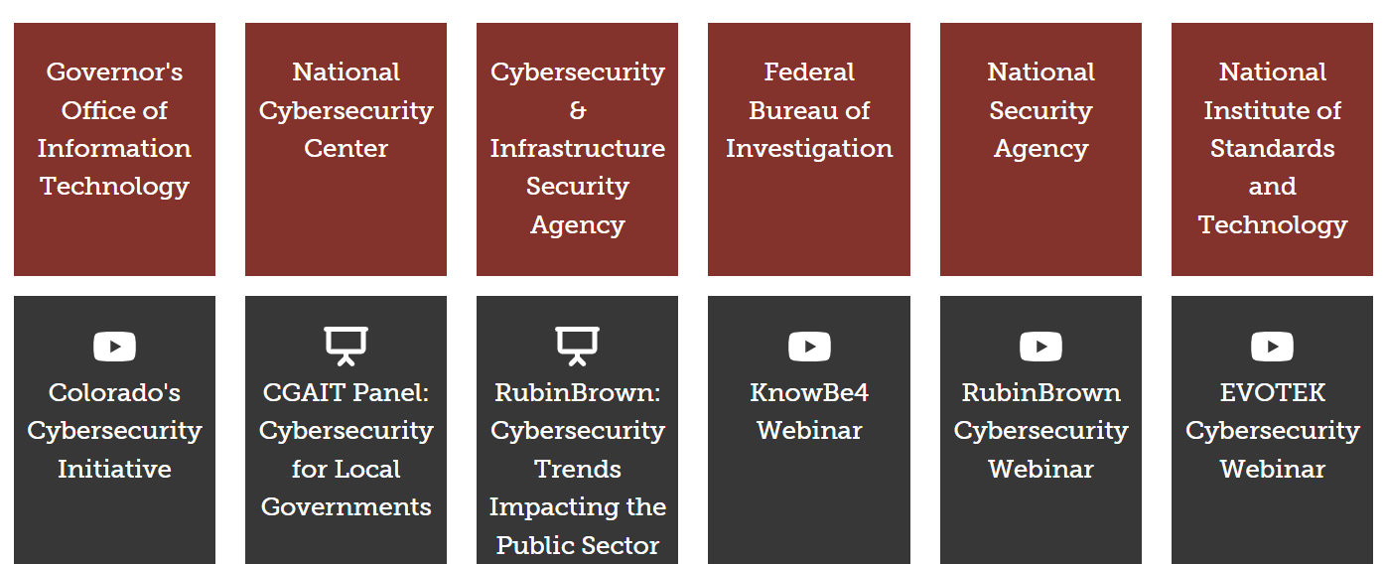
Cybersecurity Resources

Slide 16
Cybersecurity Resources
Prosecutors Center for Excellence
Multi-State Information Sharing and Analysis Center
Colorado Information Analysis Center
United States Secret Service – (recovering stolen funds)
Colorado State and Local Cybersecurity Grant Program (SGLP)
Other
Cybersecurity Resources:
Notes:
Hyperlink Question

Slide 17
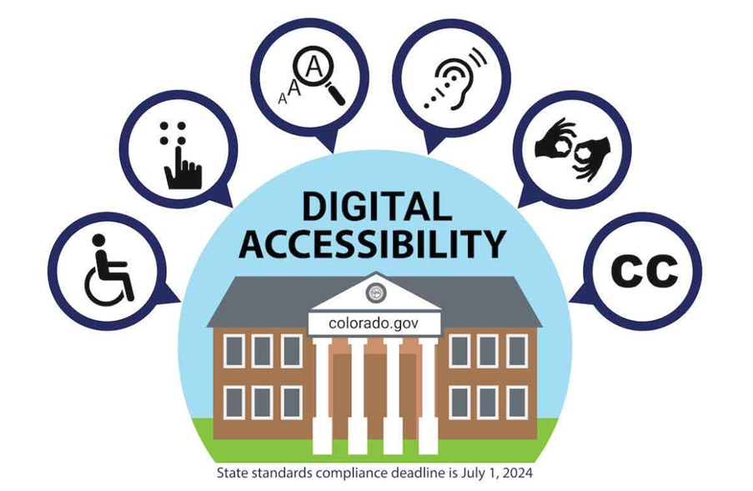
Accessibility Resources
Visit the SIPA website for information on Accessibility
●HB21-1110
●State OIT Guidelines and Publications
●Monthly Newsletters with Timely Updates
●Accessible PDFs and Documents
●Accessible Document, Presentation, Alt Text, and Images Guides
●WCAG Standards

Slide 18
Thank You
We look forward to working with you
duane@cosipa.gov
303-324-9027
950 S Cherry St., Suite 900
Denver, CO 80246
720-409-5634
sipa@cosipa.gov
sipa.colorado.gov

