Slide 1
Leveraging Partnerships for Enhanced Security
September 23, 2024

Slide 2
Introductions
Yvette Florez, Information Security Manager for the City of Lakewood
Rob Rudloff, Cyber Security Services Partner with RubinBrown

Slide 3
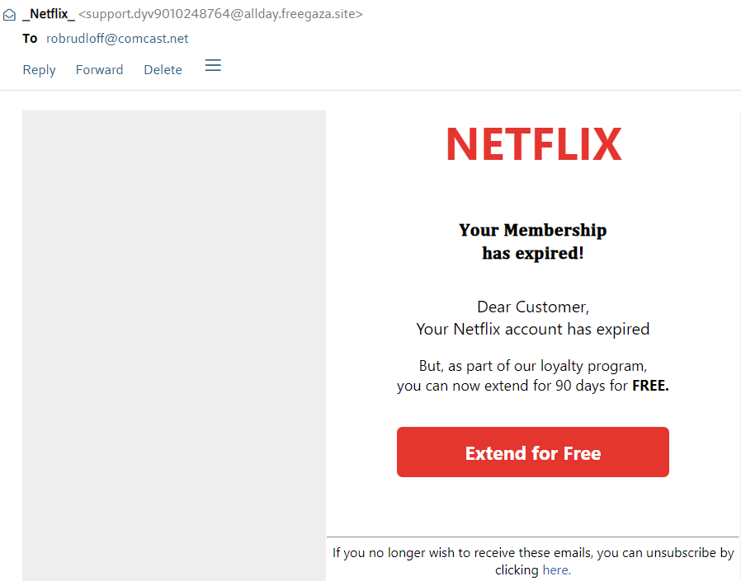
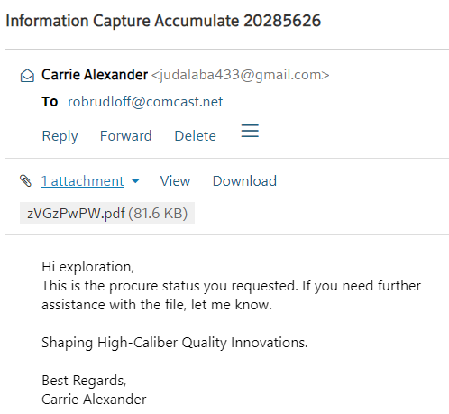
Public Service Announcement – PLEASE DON’T CLICK! (Rob to update)

Slide 4
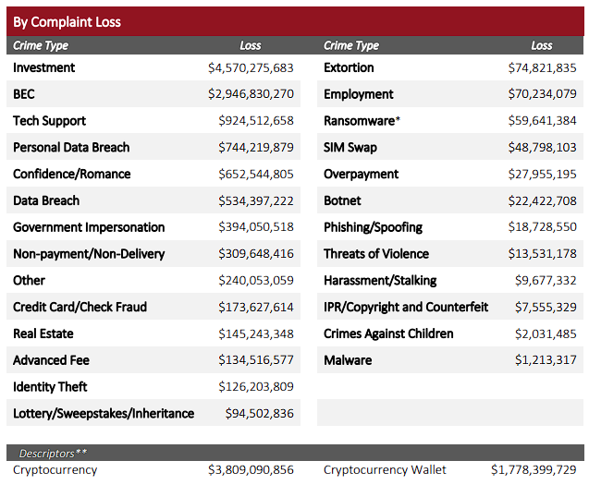
FBI Statistics
2023 FBI Internet Crime Report

Slide 5
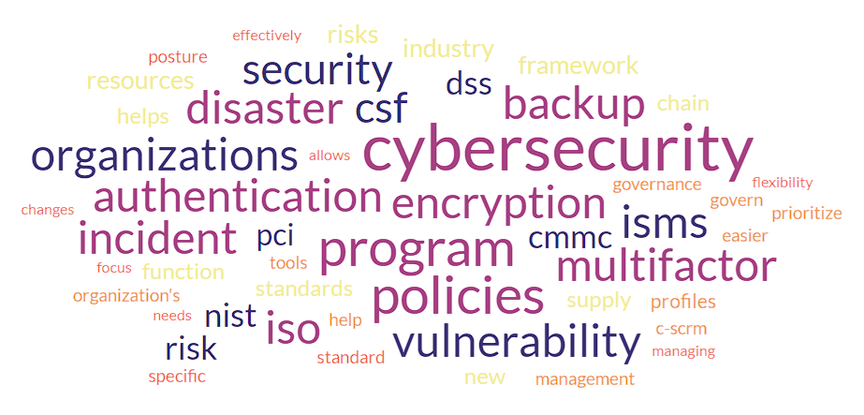
How Cyber Security Feels Sometimes…
Notes:
…and why it’s key/important to have partners. You are not in this alone. Yvette will elaborate and give examples of how partners have helped in many of these areas.

Slide 6
Anatomy of an Attack
Criminal Attacks
Application Attacks
Email
O365 / Google
Network Attacks
Main Network
On Premise Data Center
Financial Systems
Tax
Records Management
Office Support
File Storage
Remote Users
Credit Card
Environment
PCI DSS
Healthcare Data
User Environment
Workstations
Laptops
Mobile Devices
User Infrastructure
Email/Phishing Attacks
Internal Spread
Recovery
Primary Domain
External Support

Slide 7
Typical Steps of Attack and Theft
Phishing Email – compromise email credentials
Validation – validate access & assess target
Either:
Sell Credentials; or
Prepare Attack Sequence.
Reconnaissance – validate access, validate target, evaluate contents of email.
Either:
Sell Credentials and Information; or
Initiate Attack

Slide 8
Typical Steps of Attack and Theft (cont)
Identify Highest Yield Attack:
Fake Invoice
Initiate Bank Information Changes
Fake Wiring Instructions
Execute Attacks/Transfers
Sweep Money
Determine if Attack/Transfer was Detected:
No: Wash, Rinse, Repeat; or
Yes: Move on to the next target

Slide 9
Common Attacks on Government Entities
Business Email Compromise (BEC)
Wire/Invoice Fraud
Sensitive data breach/theft
Defacement and disruption
Ransomware
Notes:
Continuous training, education and awareness. A focused approach, behaviors, keep people informed, involved, inspired.
Tabletop exercises
Partnerships NOW! *FBI, CISA, USSS, EOC

Slide 10
Question
With budget and resource limitations, how do we get maximum value for our information security programs?
Partnership
Notes:
Grants, no-cost/low-cost, shared model.
SIPA, RubinBrown, MS-ISAC, CIS, NCC,
Cybersecurity Partner calls (state, local, federal)

Slide 11
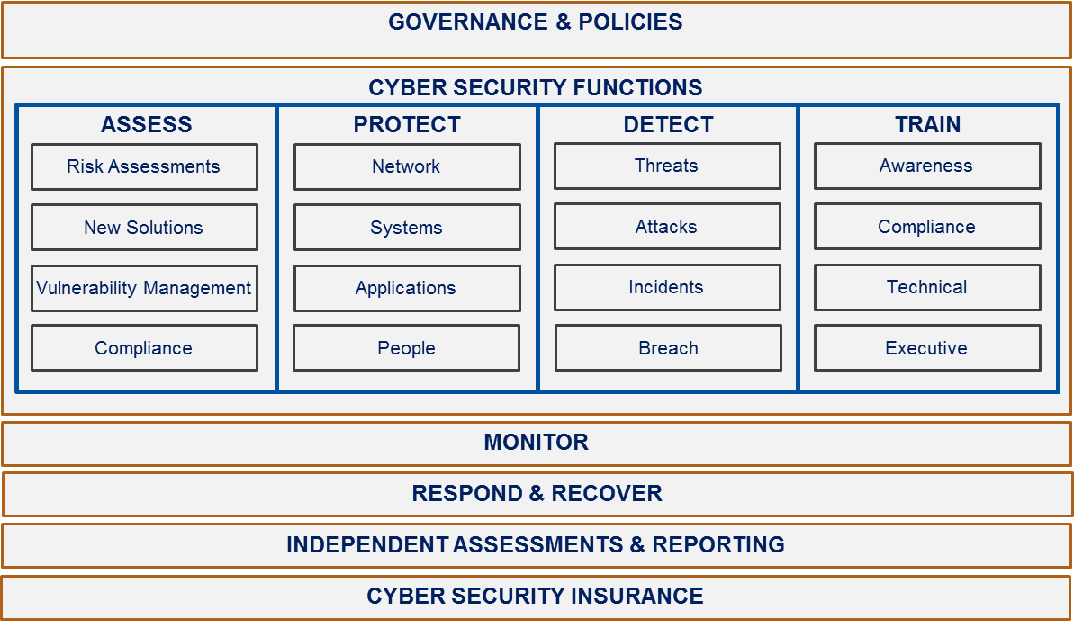
Build a Security Program
Resources &
Capabilities
People
Process
Technology
Drivers &
Requirements
Standards
Frameworks
Compliance
CIA
Assess
Cyber Security Program

Slide 12
City of Lakewood
Security Journey
Started, but more was needed
Prioritizing by risk and requirements
Partnership
Identify specialized skills needed for support
Identify vendor-partners willing to team-up for right-sized support
Notes:
Governance & Policies – gift that keeps on giving (NCSR, PCI, CJIS, Financial, re-use of tools) Drives results: posture, compliance, gap analysis, continuous improvement.
Risk Assessment: gaps, recovery, budget needs/insurance. * Just like a good incident/audit…never let it go to waste.
Crown Jewels – IR, BIA, COOP, DR

Slide 13
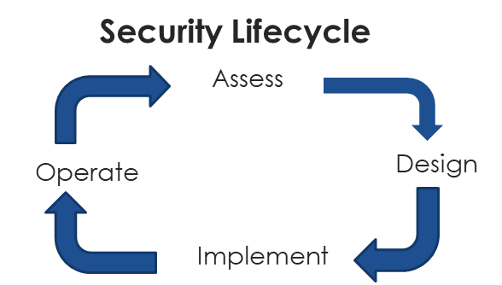
Common Threads in Security
Named Qualified Individual/Position
Formal Policies
Multifactor Authentication
Encryption
Incident Response and Disaster Recovery Plans
Backup and Recovery solution
Vulnerability Management program
Vendor (Supply Chain) Risk Management
Periodic updates and improvements

Slide 14
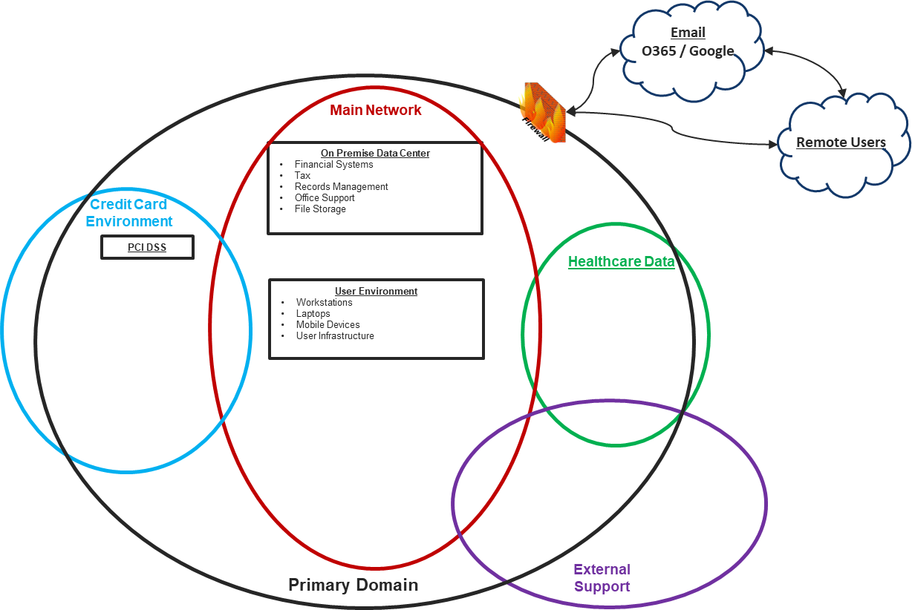
Get Started
Understand the Environment
Sensitive Data Flow Analysis
Isolate and minimize scope
Identify Control Points
Assess Control Points
Risk Based Approach
Notes:
Yvette provide example of PCI assessment with RubinBrown that included people, process, tech; value gained.

Slide 15
Additional Resources
Statewide Internet Portal Authority (SIPA)
Multi-State Information Sharing and Analysis Center (MS-ISAC)
Colorado Intergovernmental Risk Sharing Agency (CIRSA)
Department of Homeland Security (DHS)
Cybersecurity & Infrastructure Security Agency (CISA)
All Hazards Regional groups
State of Colorado groups
InfraGard

Slide 16
Questions
Rob Rudloff, CISSP, CISA, QSA
Cyber Security Services
RubinBrown LLP
303.590.8770
rob.rudloff@rubinbrown.com
Yvette Florez
Information Security Manager
City of Lakewood
303.987.7623
yflorez@lakewood.org
Notes:
Yvette is happy to share info, insight, experience and resources. Reach out!

